Slide 1
Virtual Memory
Dept. of Information Technology,
Jadavpur University, Kolkata

Slide 2
Background
Motivation
  Programs often handle large error handling code that rarely occurs
  Declare an array of 800x600 elements;most will not be used
  Some routines are less frequently used
Virtual memory – separation of logical memory from physical memory.
  Only part of the program needs to be in memory for execution
  Logical address space can therefore be much larger than physical address space
  Allows address spaces to be shared by many processes
  Less I/O—allows for more efficient process creation
Virtual memory can be implemented via:
  Demand paging
  Demand segmentation

Slide 3
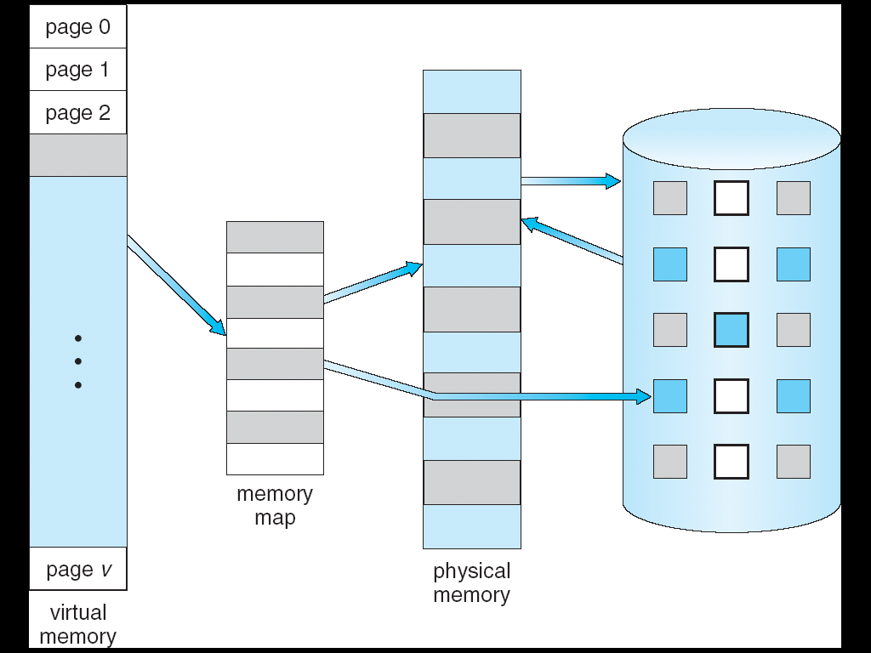
Virtual Memory That is Larger Than Physical Memory
⇒

Slide 4
Demand Paging
Bring a page into memory only when it is needed
  Less memory needed—size of the program can be extremely large
  Less I/O needed—Faster response
  More users
Page is needed ⇒ reference to it
  invalid reference ⇒ abort
  not-in-memory ⇒ bring to memory

Slide 5
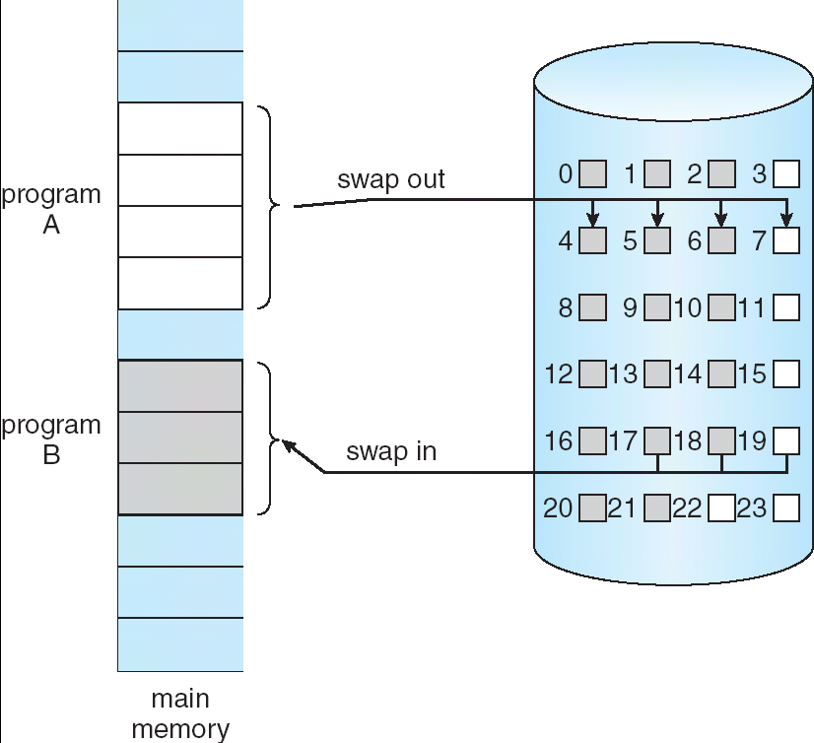
Transfer of a Paged Memory to Disk

Slide 6
Implementation of Demand Paging
With each page table entry a valid–invalid bit is associated
(v(1) ⇒ in-memory, i(0) ⇒ not-in-memory)
Initially valid–invalid bit is set to i(0) on all entries
Example of a page table snapshot:
Frame #
valid-invalid bit
v
v
During address translation, if valid–invalid bit in page table entry
is i(0) ⇒ page fault
v
v
i
….
i
i
page table

Slide 7

Example

Slide 8
Page Fault
page fault—if referenced page is not in memory
Procedure for handling page fault
  Reference the page
  If invalid reference ⇒ abort; else page fault ⇒ page to be brought into memory
  Determine the location of the page in disk
  Find a free frame (from free frame list) and read the desired page into this newly allocated frame
  Modify the page table; Set validation bit = v
  Restart the instruction that caused the page fault

Slide 9

Steps in Handling a Page Fault

Slide 10

Page Fault
Restart instruction
  block move (MVC instruction in IBM 360/370)
  Solution
    Check both ends of both blocks
      Page fault may occur even then
    Store values of overwritten locations
      Where to store? Register or memory? If stored in memory, page fault again?
  auto increment/decrement location
  MOV (R2)+, -(R3) //copies the content of location pointed //by R2 into location pointed by R3
  What will happen if a page fault occurs while accessing location pointed by R3?
  Solution
    Use status registers to store the initial values of registers R2 and R3 so that the instruction can be undone
Destination
Block
Source
block
Page fault

Slide 11
Performance of Demand Paging
Page Fault Rate 0 ≤ p ≤ 1.0
  if p = 0 no page faults
  if p = 1, every reference is a fault
Effective Access Time (EAT)
EAT = (1 – p) x memory access
+ p(page fault overhead + swap page out + swap page in + restart overhead )
Page fault service time
Example
Memory access time = 100 ns
Page fault service time = 25 ms
EAT = (1-p)x100+px25,000,000 = 100+29,999,900xp
If p=0.001 (1 out of 1000),
EAT=25 μs (slow down by a factor of 250!!!!)
For 10% performance degradation p < 0.0000004 (1 out of 2,500,000)

Slide 12
Page Replacement
Page fault→There is no free frame in memory→page replacement
  Page replacement completes separation between logical memory and physical memory – large virtual memory can be provided on a smaller physical memory
  Include pagereplacement algorithm into page-fault service routine
find some page in memory, but not really in use, swap it out
  algorithm
  performance – want an algorithm which will result in minimum number of page faults
Use modify (dirty) bit to reduce overhead of page transfers – only modified pages are written to disk

Slide 13

Need For Page Replacement

Slide 14
Basic steps Replacement
Find the location of the desired page on disk
Find a free frame:
  If there is a free frame, use it
  If there is no free frame, use a page replacement algorithm to select a victim frame
  Write the victim page to the disk (if necessary); change the page and frame tables accordingly
Bring the desired page into the free frame;
update the page and frame tables
Restart the process

Slide 15

Page Replacement

Slide 16

Page Faults Versus The Number of Frames

Slide 17
Page Replacement Algorithms
Want lowest page-fault rate
Evaluate algorithm by running it on a particular string of memory references (reference string) and compute the number of page faults on that string
In all our examples, the reference string is
7, 0, 1, 2, 0, 3, 0, 4, 2, 3, 0, 3, 2, 1, 2, 0, 1, 7, 0, 7

Slide 18

First-In-First-Out (FIFO) Algorithm
Page that was loaded first will be replaced
Example:
  Reference string: 7, 0, 1, 2, 0, 3, 0, 4, 2, 3, 0, 3, 2, 1, 2, 0, 1, 7, 0, 7
  3 frames (3 pages can be in memory at a time per process)
15 page faults
Implementation:
  Use FIFO queue; referenced page will be added at the rear end
  Page at the head will be replaced

Slide 19
Belady’s anomaly
Reference string: 1, 2, 3, 4, 1, 2, 5, 1, 2, 3, 4, 5
3 frames (3 pages can be in memory at a time per process)
1
2
3
4
1
2
5
1
2
3
4
5
1
1
1
1
4
4
4
5
5
5
2
2
2
2
1
1
1
3
3
9 page faults
3
3
3
3
2
2
2
4
4 frames
1
2
3
4
1
2
5
1
2
3
4
5
1
1
1
1
1
5
5
5
5
4
4
2
2
2
2
2
1
1
1
1
5
10 page faults
3
3
3
3
3
2
2
2
2
4
4
4
4
4
3
3
3

Slide 20

FIFO Illustrating Belady’s Anomaly

Slide 21

Optimal Page Replacement
Replace page that will not be used for longest period of time
FIFO Page replacement
Optimal Page replacement
9 page faults

Slide 22
Optimal Algorithm
4 frames example
1, 2, 3, 4, 1, 2, 5, 1, 2, 3, 4, 5
1
2
3
4
1
2
5
1
2
3
4
5
1
1
1
1
1
1
4
2
2
2
2
2
2
6 page faults
3
3
3
3
3
4
4
5
5
How do you know this?
Used for measuring how well your algorithm performs

Slide 23

Least Recently Used (LRU) Algorithm
Uses the locality of reference property
Use the concept of optimal algorithm but look backward instead of looking forward
Replace the page that has not been used longest period of time
12 page faults

Slide 24
Least Recently Used (LRU) Algorithm
Reference string: 1, 2, 3, 4, 1, 2, 5, 1, 2, 3, 4, 5
1
1
1
1
5
2
2
2
2
2
3
5
5
4
4
4
4
3
3
3
Implementation of LRU
  Counter implementation
    Every page entry has a counter; every time page is referenced through this entry, copy the clock into the counter
    When a page needs to be changed, look at the counters to determine which are to change
  Problems:
    Write counter to the memory—memory access
    Searching the page with smallest counter value

Slide 25

LRU Algorithm (Cont.)
Stack(Queue) implementation
  keep a stack (queue) of page numbers in a double link form:
  Maintain two pointers head and tail pointing to top(head) and bottom (tail) of stack (queue)
  Whenever a page is referenced:
    Remove it and put it on the top/head
Remove the page at the bottom/rear(this is the least recently used page)

Slide 26
LRU Algorithm (Cont.)
  Advantage
    Limited number of pointers to be changed
    No search for replacement
  Disadvantage
    Searching for update is expensive
  Neither optimal nor LRU algorithm suffers from Belady’s anomaly

Slide 27
LRU Approximation Algorithms
Reference bit
  With each page associate a bit, initially = 0
  When page is referenced bit set to 1
  Replace the one which has this bit set 0 (if one exists)
Use additional reference bits
  Use 8-bit shift register
  OS periodically stores the reference bit in this store
  Replace the page with smallest register value

Slide 28

Second-Chance Page-Replacement Algorithm
Extension of FIFO
  Need reference bit
  If page to be replaced has reference bit = 1 then:
    set reference bit 0 (implies that the page will not be replaced until all other pages are replaced—second chance)
    leave page in memory
    replace next page (in FIFO order), subject to same rules

Slide 29
LRU Approximation Algorithms
Enhanced Second chance
  Need two reference bits
    One indicates whether the page is referenced or not
    Other indicates whether the page has been modified
  (0, 0)—neither recently used nor modified—best page to replace
  (0, 1)—not recently used but modified—not so good to replace
  (1, 0)—recently used but clean—probably will be used soon
  (1, 1)—recently used and modified—worst page to replace

Slide 30
Counting Algorithms
Keep a counter of the number of references that have been made to each page
LFU Algorithm: based on the argument that the page is not being used frequently and will not be used later
MFU Algorithm: based on the argument that the page is being used frequently, so there is a small chance that the page will be used further

